Slide 1
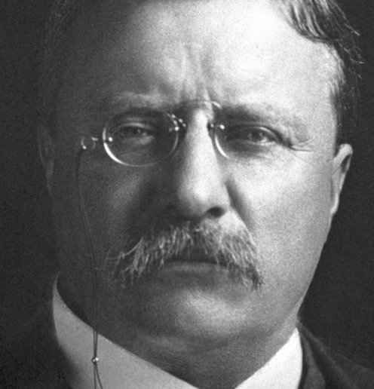
Theodore Roosevelt
26th President of the United States (1901 to 1909)
https://www.youtube.com/watch?v=Z-M1-VqEEPA

Slide 2

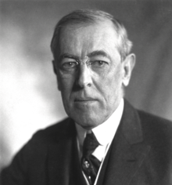
Woodrow Wilson
28th President of the United States from 1913 to 1921
https://www.youtube.com/watch?v=xJ7G0MJ_Y2Q

Slide 3
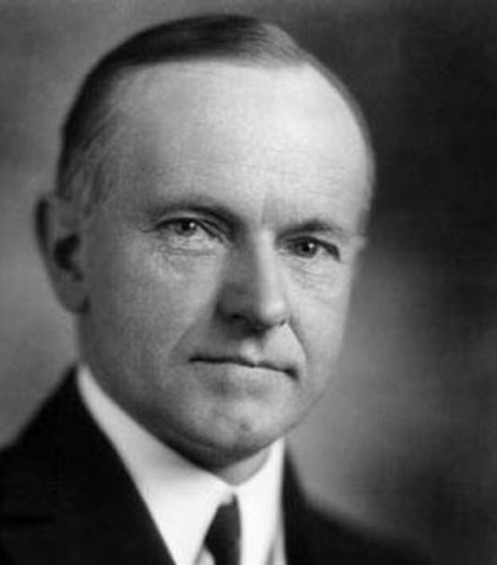
Calvin Coolidge
30th President of the United States (1923 – 4 March 1929)

Slide 4
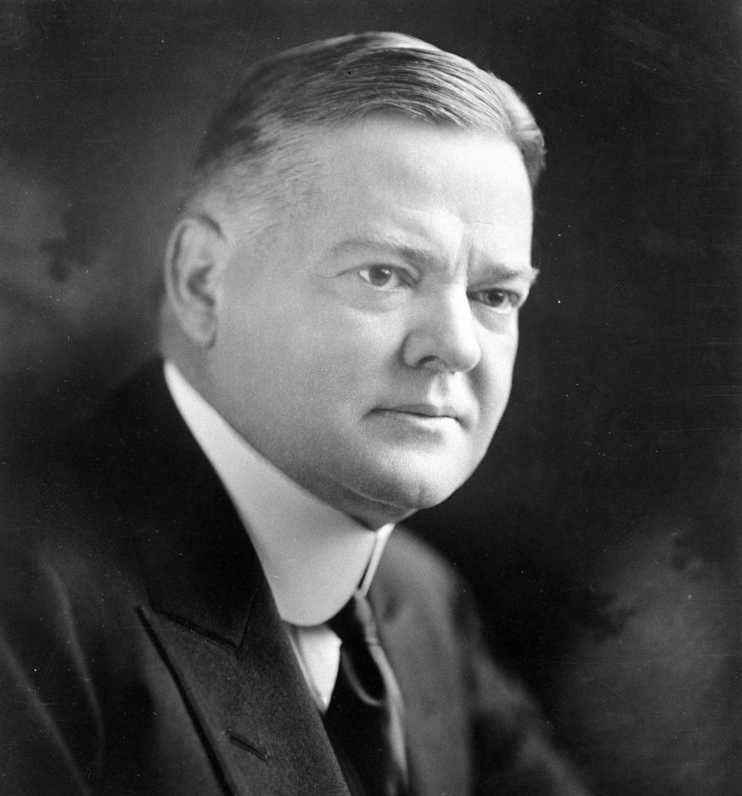
Herbert Hoover
31st President of the United States from 1929 to 1933 during the Great Depression.
https://learningenglish.voanews.com/a/americas-presidents-herbert-hoover/4037382.html

Slide 5
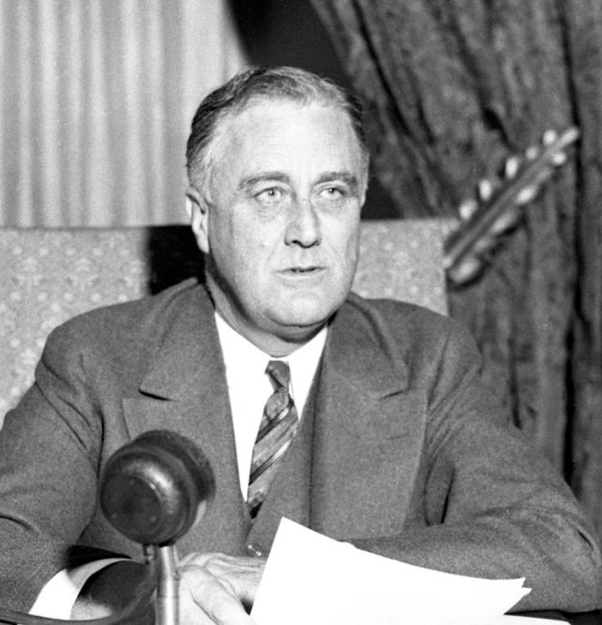
F D Roosevelt
32nd President of the United States from 1933 until his death in 1945.
https://learningenglish.voanews.com/a/americas-presidents-franklin-roosevelt/4046663.html

Slide 6

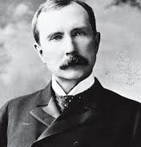
J D Rockefeller
John Davison Rockefeller Sr. was an American oil industry business magnate, industrialist, and philanthropist. He is widely considered the wealthiest American of all time, and the richest person in modern history.

Slide 7
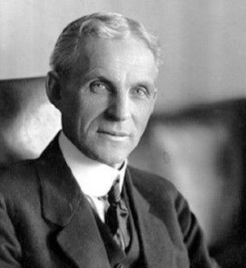
Henry Ford
Henry Ford was an American captain of industry and a business magnate, the founder of the Ford Motor Company, and the sponsor of the development of the assembly line technique of mass production.
https://www.biography.com/people/henry-ford-9298747

